Slide 1
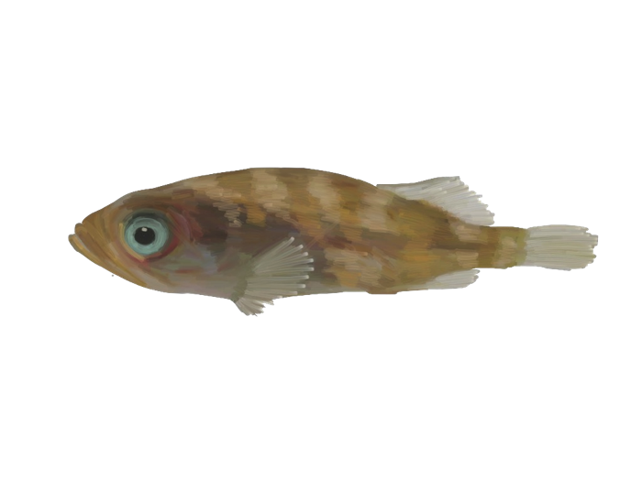
Rockfish Data For Publication
Sara Michele Schaal
Images: © KE Lotterhos

Slide 2
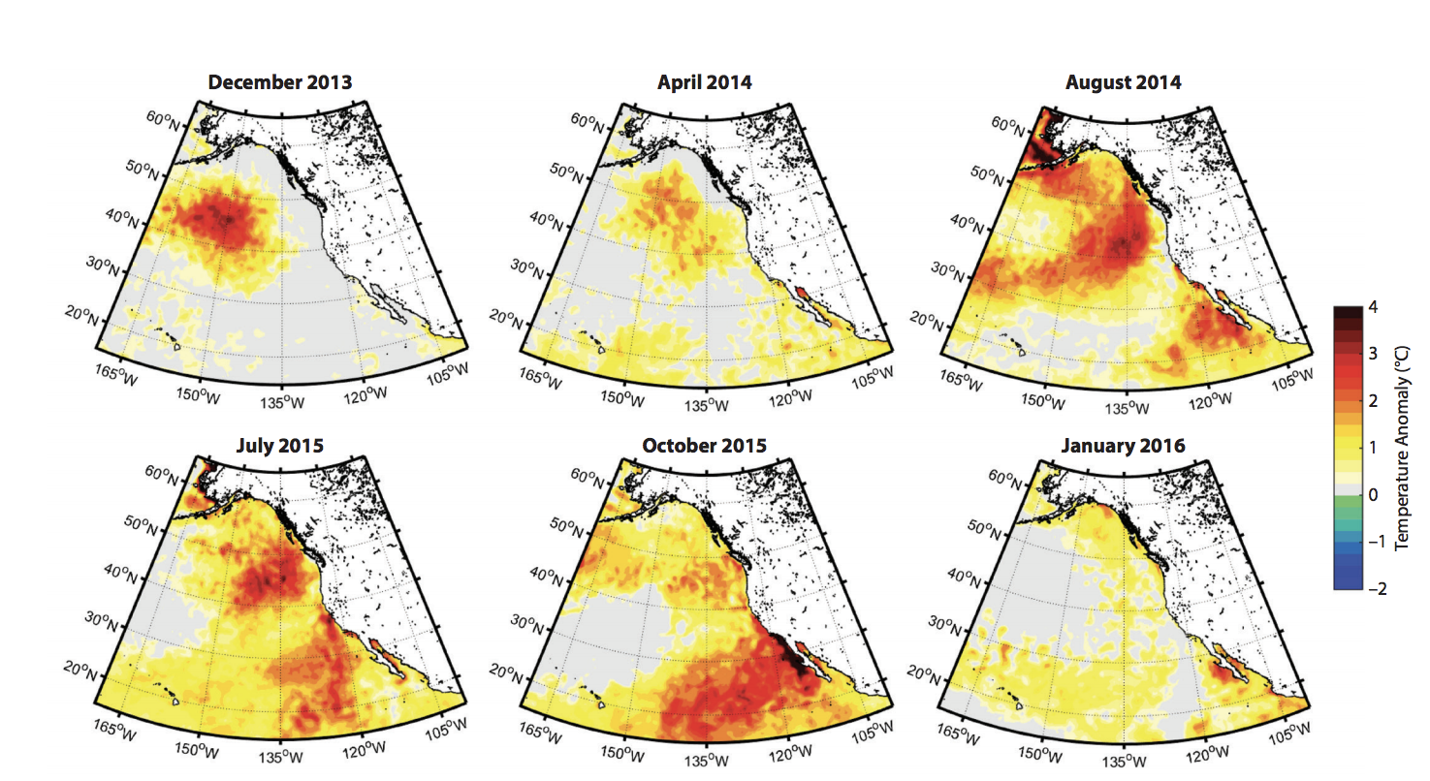
Temperature Anomaly
2013-2015 “The Blob”
Rockfish showed increased recruitment in California
Cavole et al. 2016 Oceanography

Slide 3
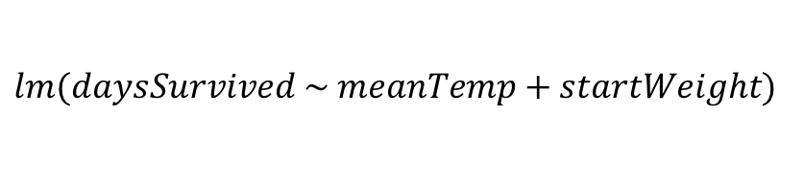
Mortality Data
$$lm(daysSurvived \sim meanTemp+startWeight)$$
N = 29
Black
N = 39
Copper
Species Specific Mortality Across Temperatures
Need to redo analysis with a different model…
Days Survived
ns
-0.25 +/- 0.11 *
N = 9
Yellowtail
N = 21
Quillback
ns
-0.48 +/- 0.21 *
14
21
22
23
Temperature(℃)
Notes:
For all analyses we did model selection based on AIC value comparison. Terms were dropped from the model if they improved the model by at least 2 AIC points.
Mortality data we used a linear model with mean temperature and individual weights as main effects

Slide 4
Mortality Data
Figure Out Correct Model
Cox hazard ratio model – “The Cox proportional-hazards model (Cox, 1972) is essentially a regression model commonly used statistical in medical research for investigating the association between the survival time of patients and one or more predictor variables”
However, I have 16 treatments with only 2-4 individuals per treatment.. I don’t think I can do survival curve per temperature..
Notes:
For all analyses we did model selection based on AIC value comparison. Terms were dropped from the model if they improved the model by at least 2 AIC points.
Mortality data we used a linear model with mean temperature and individual weights as main effects

Slide 5
Mortality Data
Logistic Regression of Lived/Died by Temperature
Lose some data resolution by not including number of days survived
Notes:
For all analyses we did model selection based on AIC value comparison. Terms were dropped from the model if they improved the model by at least 2 AIC points.
Mortality data we used a linear model with mean temperature and individual weights as main effects

Slide 6
Mortality Data
Logistic Regression of Days Survived (Proportion of 14 days)
95% CI intervals in grey
Notes:
For all analyses we did model selection based on AIC value comparison. Terms were dropped from the model if they improved the model by at least 2 AIC points.
Mortality data we used a linear model with mean temperature and individual weights as main effects

Slide 7

Growth Rate
$$lm(percentWeight\sim meanTemp+startWeight)$$
% Weight Change:
Species Specific Growth Rates with Temperature Affecting Copper and Quillbacks Most
Only those individuals who survived entire experiment
Notes:
Significant effect of temperature on growth for all species however, the effect size is greatest in the copper experiment compared to the black

Slide 8
Growth Rate
$$lm(percentWeight\sim meanTemp+startWeight)$$
Only those individuals who survived entire experiment
Quillbacks come out slightly significant but N = 6? Was going to color by Quillback and all others as a single color but I don’t think I should separate the quillbacks out because of sample size
% Weight Change:
Notes:
Significant effect of temperature on growth for all species however, the effect size is greatest in the copper experiment compared to the black

Slide 9
Growth Rate
$$lm(percentWeight\sim meanTemp+startWeight)$$
Only those individuals who survived entire experiment
Quillbacks come out slightly significant but N = 6? Was going to color by Quillback and all others as a single color but I don’t think I should separate the quillbacks out because of sample size
% Weight Change:
Notes:
Significant effect of temperature on growth for all species however, the effect size is greatest in the copper experiment compared to the black

Slide 10
Growth Rate
$$lm(percentWeight\sim meanTemp+startWeight)$$
% Weight Change:
Species Specific Growth Rates with Temperature Affecting Copper and Quillbacks Most
Only those individuals who survived entire experiment
Black Rockfish Experiment
Copper Rockfish Experiment
-1.44 +/- 0.24 ***
Copper: -2.56 +/- 0.92 **
Quill: -3.38 +/- 0.96 *
Percent Weight Change
Temperature (℃)
Temperature (℃)
No Species Interaction – Analyzed Together
Notes:
Significant effect of temperature on growth for all species however, the effect size is greatest in the copper experiment compared to the black

Slide 11
Activity Data
CQ Rockfish
Notes:
Black wide range in temperature tolerance
High individual variability
Greater weight loss

Slide 12
Activity Data
Mean Activity
Temperature
Notes:
Black wide range in temperature tolerance
High individual variability
Greater weight loss

Slide 13
Activity Data
BY Rockfish
Notes:
Black wide range in temperature tolerance
High individual variability
Greater weight loss

Slide 14
Activity Data
BY Rockfish
-0.12 *** +/- 0.016
Notes:
Black wide range in temperature tolerance
High individual variability
Greater weight loss

Slide 15
Activity Data
Copper Rockfish
Notes:
Black wide range in temperature tolerance
High individual variability
Greater weight loss

Slide 16
Activity Data
Black Rockfish
Notes:
Black wide range in temperature tolerance
High individual variability
Greater weight loss

Slide 17
Big Picture Story
Effect as Temperature Increases on Each Trait
Species | Mortality | Growth | Mean Activity | Activity Over Time
Copper | Increasing * | Decreasing * | Decreasing * Decline with temperature gets worse over time | Greater Effect
Quillback | Overall lower | Overall lower & Decreasing * |  | Greater Effect
Black | ns | Decreasing * | Decreasing * decline with temperature stays constant over time | No Difference
Yellowtail | ns | Decreasing * |  | No Difference
Copper are affected by prolonged stress via mortality and activity with a slightly higher reduction in growth compared to black rockfish.
Black rockfish show lowered performance at highest temperatures that is consistent over time.
Notes:
Black wide range in temperature tolerance
High individual variability
Greater weight loss

Slide 18

Timeline
Submit To
Global Change Biology – see what they are publishing
Marine Ecology Progress Series
Standard Deviation of Temperature in the Buckets for the Experiment in a Supplement
Images of fish to compare within complexes
End of February - Draft
Submit end of march
Body size and thermal performance in the lit

